Slide 1
Fundamentals and Methods of Computer Science
Exercise Week 01

Slide 2
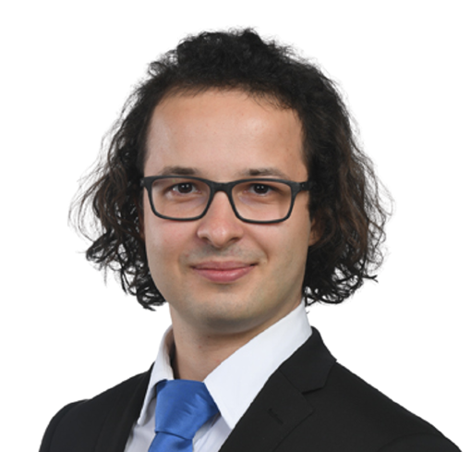
Intro
Who am I?
Dominik Buchegger, 27
I have a B.A. HSG in Law & Economics… …but didn’t enjoy the Law part that much.
Therefore, I did a B.A. HSG in Business Administration… …and realized I don’t want to do a business master.
Currently, I am writing my thesis for the MBF while also pursuing courses for the MSc Statistics at ETH.
9th time tutoring for this course
And if you are scared by now from the overwhelming course content: I learned programming 5 years ago in this exact course.

Slide 3
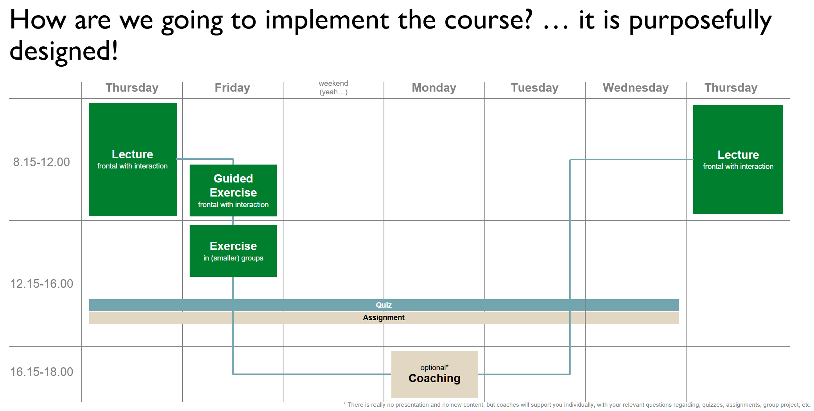

Slide 4
Important dates
Week 02: Discussion of project expectations and requirements
Week 03: Group definition / assignment, Q&A for project​
Week 04: Primer on Machine Learning
Week 05: (Optional) Presentation of project idea / approach
Feedback (max. 10 minutes/group)
Week 06: (Optional) Presentation of project idea / approach
Feedback (max. 10 minutes/group)
Break
Week 07: No Live Lecture → Video (Easter)
Week 08: No Live Lecture → Video (I’m busy)
Week 09: (Optional) Presentation of MVP
Feedback (max. 10 minutes/group)
Week 10: (Optional) Presentation of MVP
Feedback (max. 10 minutes/group)
Week 11: Upload of solution, presentation video and Q&A session*
Week 12: No In-Person Lecture → Video + Live Zoom QA (End of semester)
*) This is an official examination date. If you can’t make it to the session, you have to discuss this with your group and your exercise session tutor in advance. Not doing so may lead to exclusion from the group work and grade.

Slide 5
What is the general idea of the exercises?
Computer science implementation competence cannot be achieved through frontal teaching only
Similar to learning an instrument, it is necessary that we actively practice
To guide practicing, we have weekly assignments (and their assessments, i.e., the quizzes) as well as the group project
In the weekly exercises we
Discuss the previous week’s assignment and respective quiz (in depth) → starting next week
Briefly summarize the current week’s lecture contents
Work on the group project (on request)
Provide (some) time and support for the current week’s assignment
In our small(er) group we have sufficient time and opportunity for discussing your individual questions.

Slide 6
Today’s Menu
Getting you a working Python / Jupyter Notebook environment
Summary of Lecture content
Short summary of Coding Python in 7 Slides
Enable you to find, download, (unzip), load, and work on the first notebook

Slide 7
Python/Jupyter Notebooks

Slide 8

Python / Jupyter Notebook
Having a running Python and Jupyter Notebook available is crucial, because …
All the assignments will need such an environment
All the lectures will provide their contents via notebooks
Let’s do it … now
If there is one thing you should have by today it is a running Python / Jupyter Notebook.

Slide 9
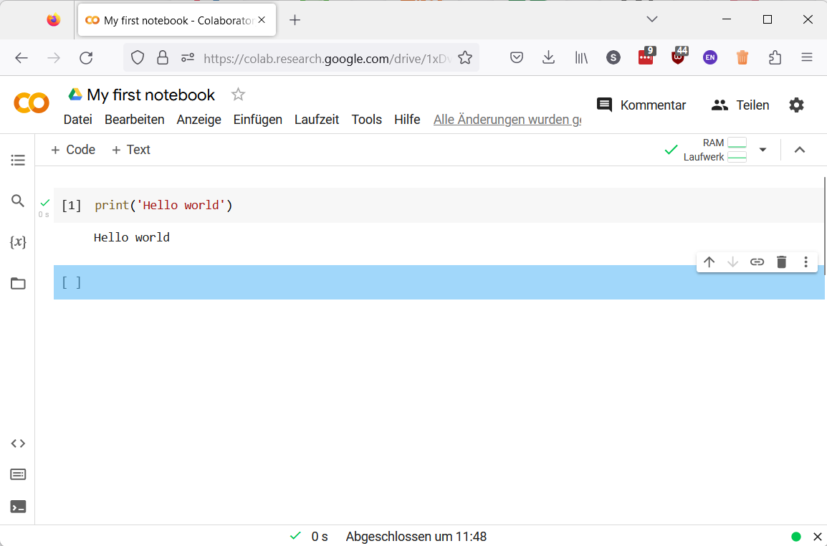
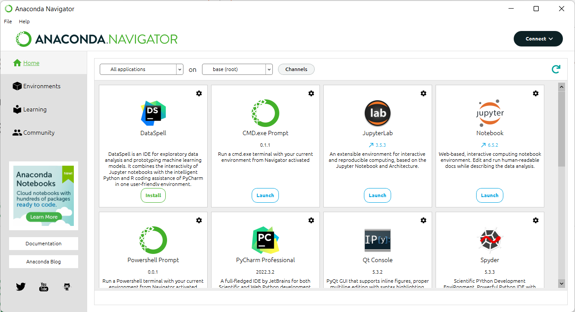
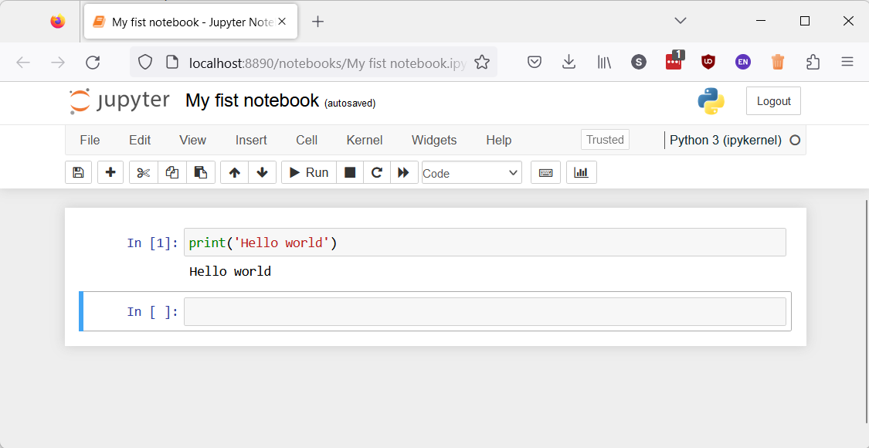
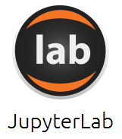

On your machine or in the cloud
While there are many more options, we support two ways of running Python/Jupyter Notebooks
On your machine: Anaconda
In the cloud: Google Colab
Anaconda is an easy to install and easy to use Python distribution that comes with everything we need.
Download https://www.anaconda.com/products/distribution
Run
You typically need a Google account
Find https://colab.research.google.com/
Upload your notebook
We highly recommend a local Python installation on your machine. This will be helpful for the group project.

Slide 10
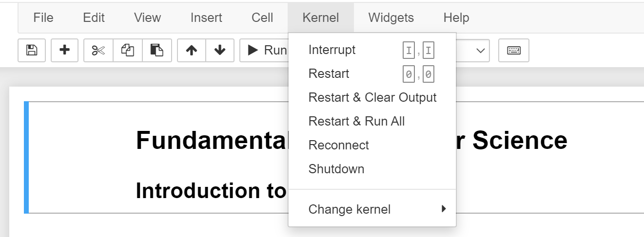
Troubleshooting in Jupyter
If your Jupyter Notebook:
does not run anymore, or
is taking more than a few (reasonable) seconds
Restart the Kernel!

Slide 11
Summary of Lecture Content

Slide 12
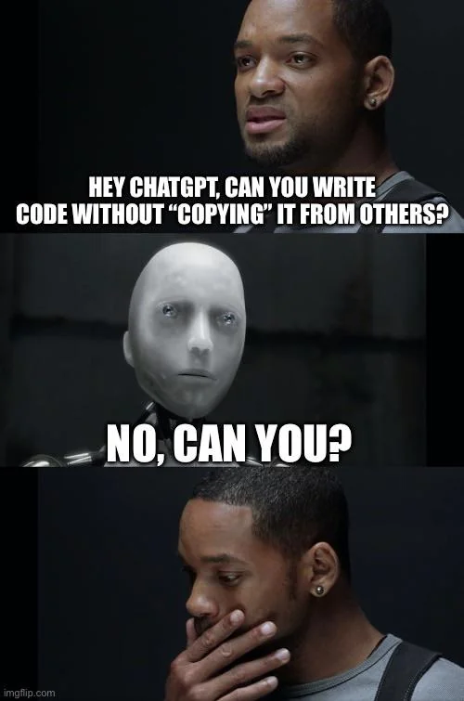

What is…?
Computer Science
Science of the efficient automation of processes
Programming
Splitting big tasks in smaller tasks that our computer can handle.
Using a certain language that the computer understands to give instructions.
Reuse. Reuse. Reuse.

Slide 13

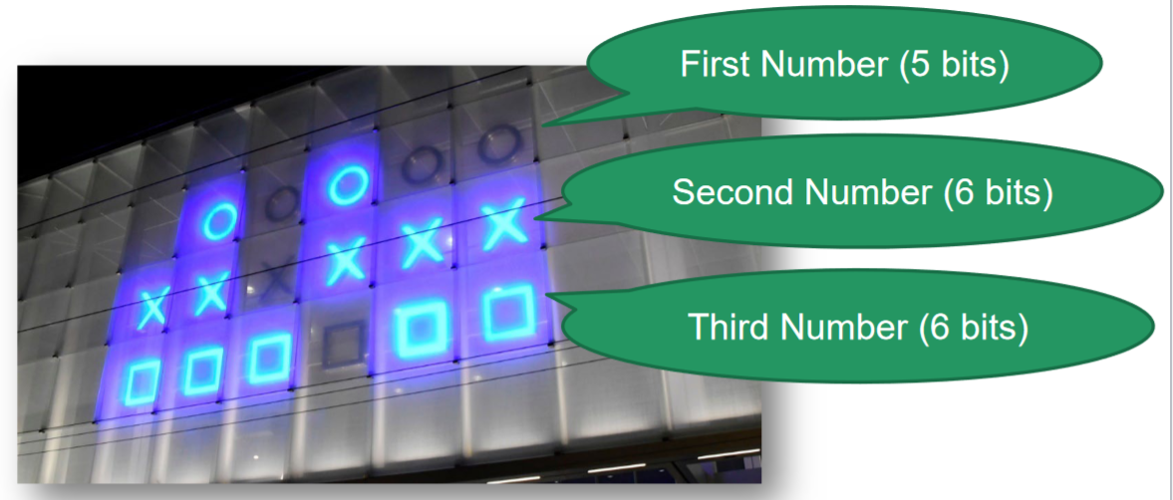
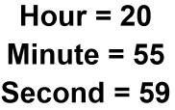





Bits (Binary Digits) & Bytes
Information = Bits (1/0; logical values True/false) + Context (Encoding)
Data in Bytes (usually 8 bits) → numbers 0-255($2^{n}−1$) [2^8 numbers]
Check your understanding by thinking about a hexadecimal clock - convention: leading ‘0x’

Slide 14
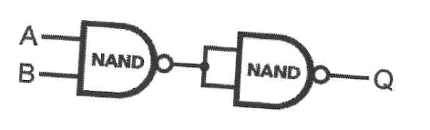
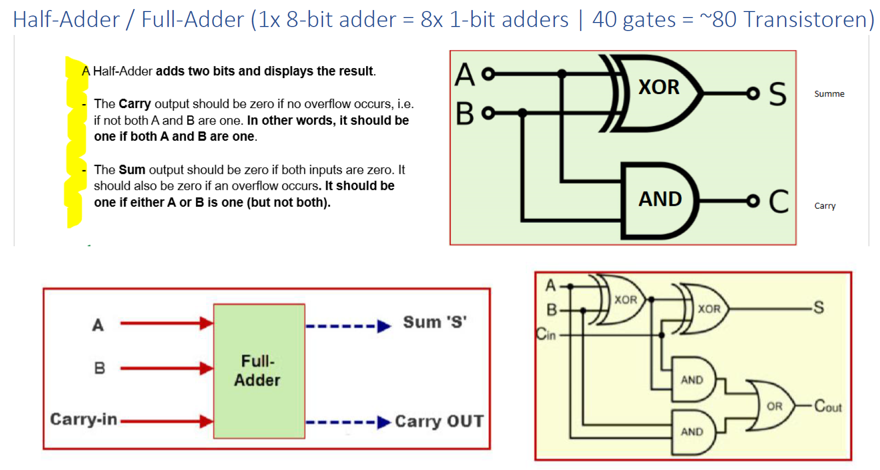
Boolean Algebra & NAND Gates
Boolean Algebra:
E.g. X=True=1, y=False=0
NOT ~x = 0;
AND (x & y) = 0;
OR (x | y) = 1;
XOR (x ^ y) = 1;
Transistors (electronical switches used today) can represent 0 & 1 (True & False) → in combination we can build all logical symbols
Functional Completeness of NAND:
NOT: A NAND A
AND: (A NAND B) NAND (A NAND B)
OR: (A NAND A) NAND (B NAND B)
XOR: (A NAND (A NAND B)) NAND (B NAND (A NAND B))
NOR: NOT(A OR B)
XNOR: NOT(A XOR B)
Half-adder & Full-adder

Slide 15
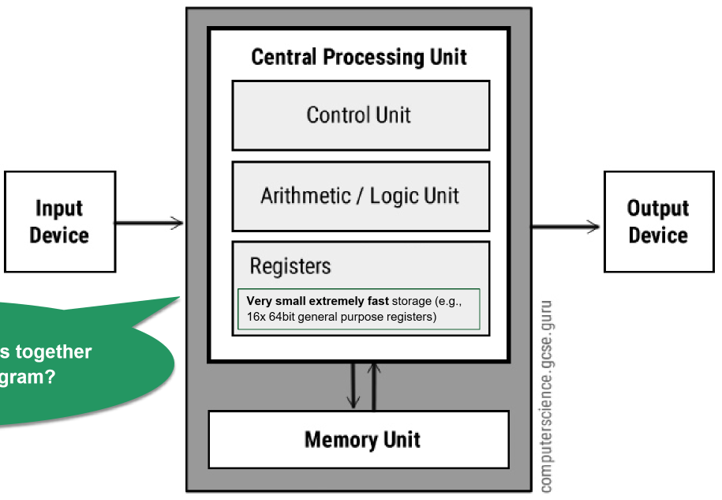
Arithmetic/Logic Unit (ALU) & Central Processing Unit (CPU)
CPU runs in a loop. In each cycle the CPU uses instructions to load data in the registers and computes the result to store in the memory unit.
Adding, Multiplier, Substractor & Divisor Circuits (4 Units) +
Memory for Input/Output +
Function select bits
Everything is a binary string interpreted as executable instructions.
Do you understand this task from the lecture?
10001110010010010100000000001

Slide 16
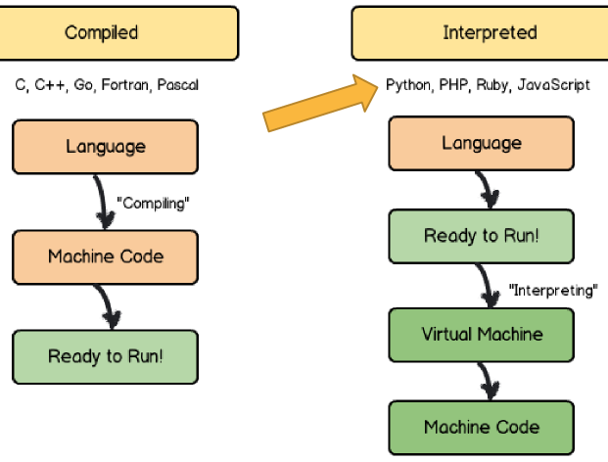
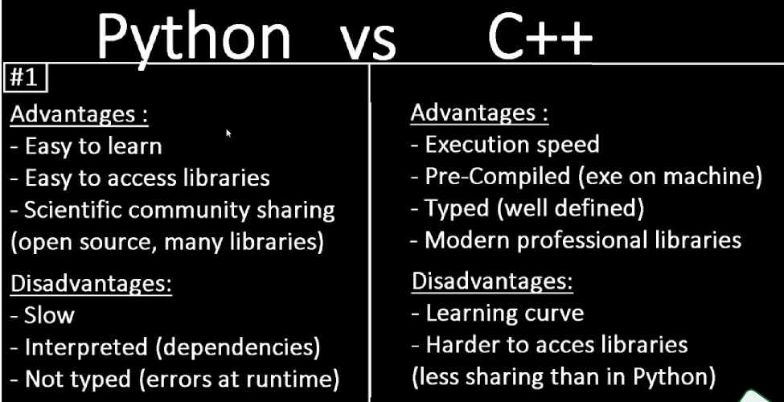
Compiled vs Interpreted Programming Languages
Compiled languages translate & validate the program before running, while interpreted languages are directly ready.

Slide 17
Short “summary” of Coding Python in 7 Slides
This week we have some (very) quick start to be able to write some first program – in the next weeks we will take more time to properly introduce and extend some this week’s concepts.

Slide 18
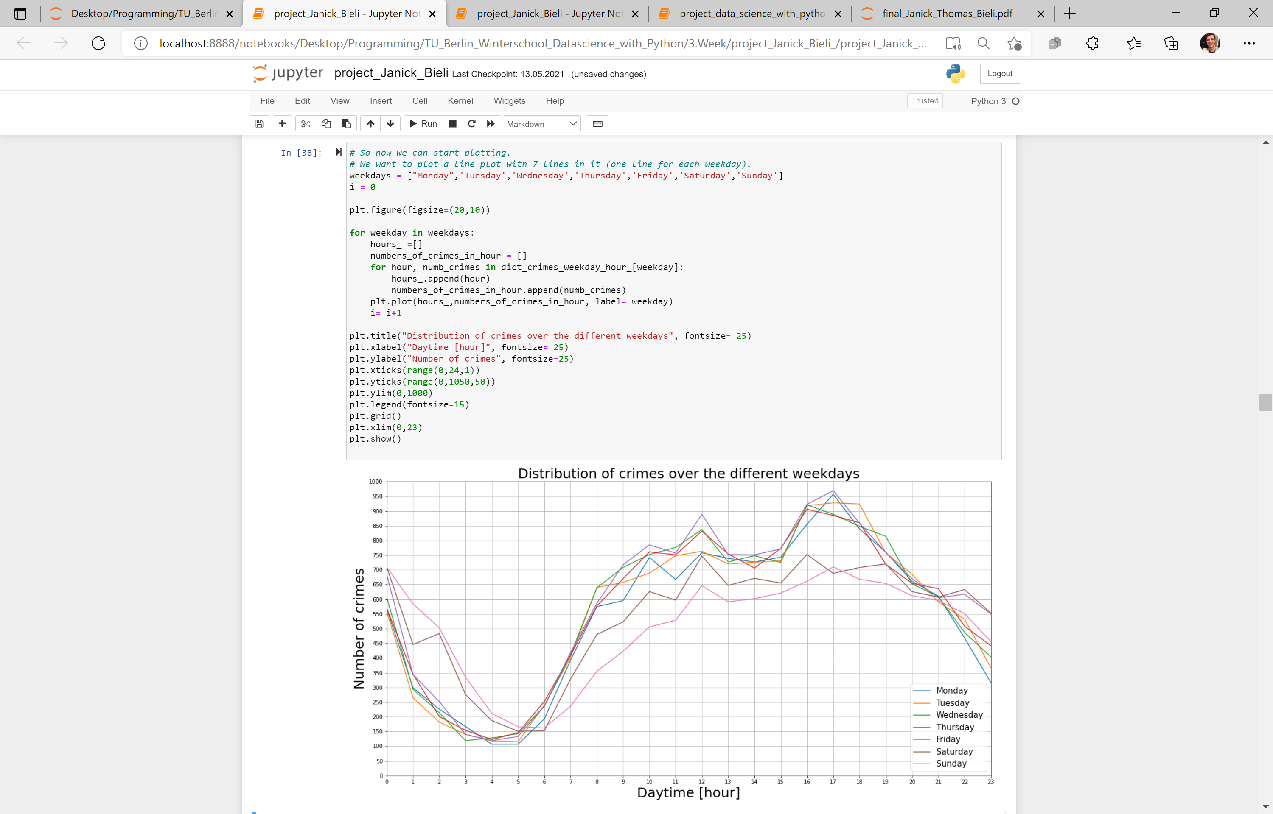
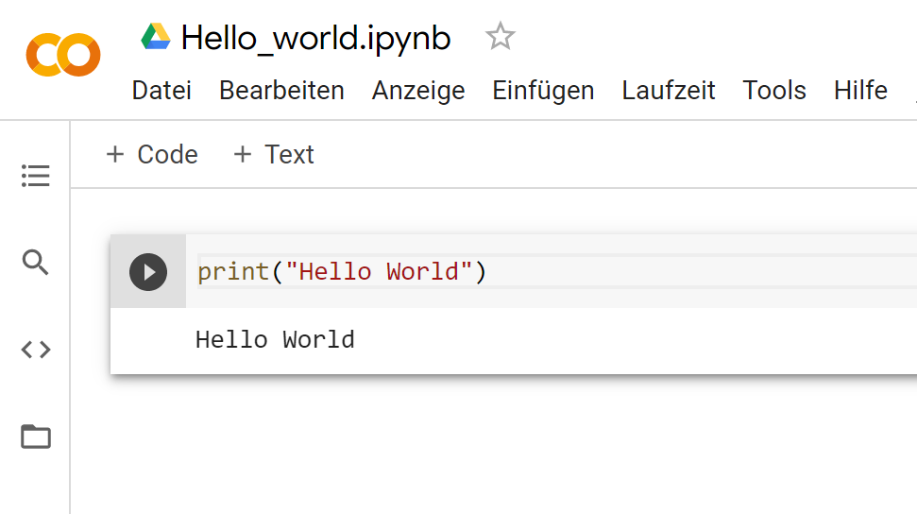
Our goal over the semester
This week we have some (very) quick start to be able to write some first program – in the next weeks we will take more time to properly introduce and extend some of this week’s concepts.

Slide 19
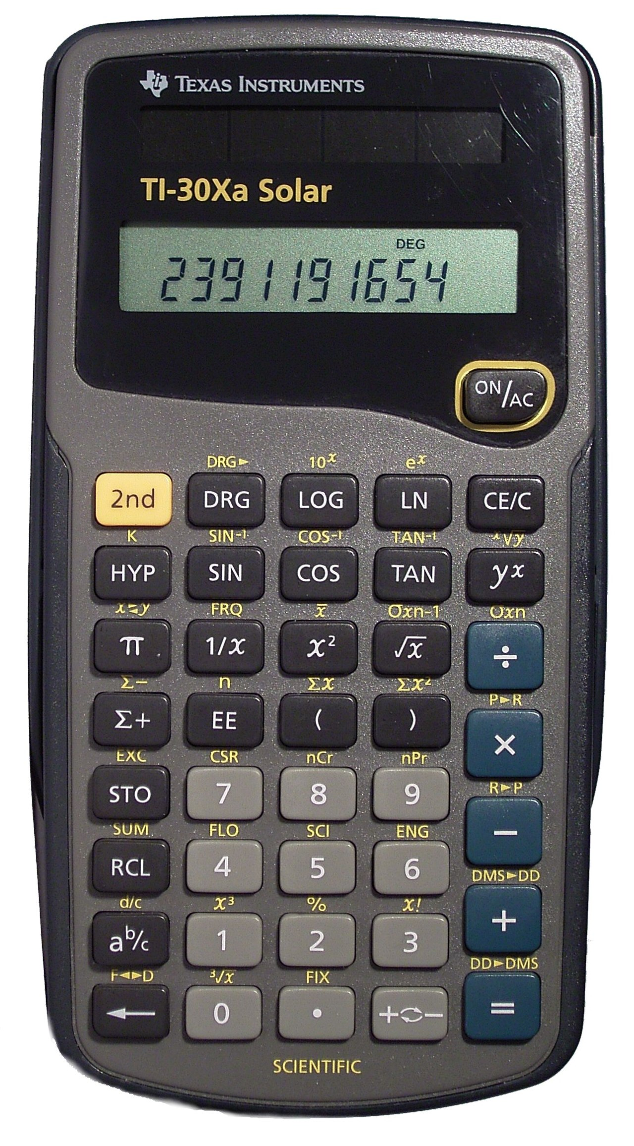
Introduction
A Simple Calculator as your first computer program!
You will learn how to assign values to variables and to do basic calculations
There are among others the following arithmetic operations in Python:
Addition: +
Subtraction: -
Multiplication: *
Division: /
Power Function: **
Example: 3**2 = 9 same as 3^2 (often written like that in Excel)
Modulo Function: %
In computing, the modulo operation returns the remainder of a division, after one number is divided by another (called the modulus of the operation)
Example: 17 % 5 = 2 (15/5 = 3 → the remainder up to 17 is 2)
So, Modulo does integer divisions and returns the remainder

Slide 20
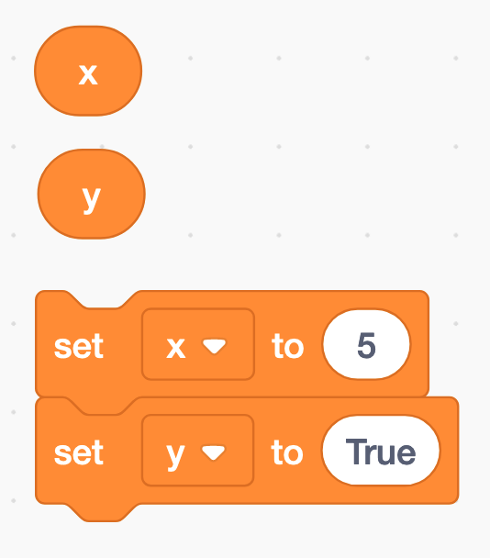
Assigning a value to a variable
The equal sign (=) is used to assign values to variables
x = 5
y = True
etc.

Slide 21
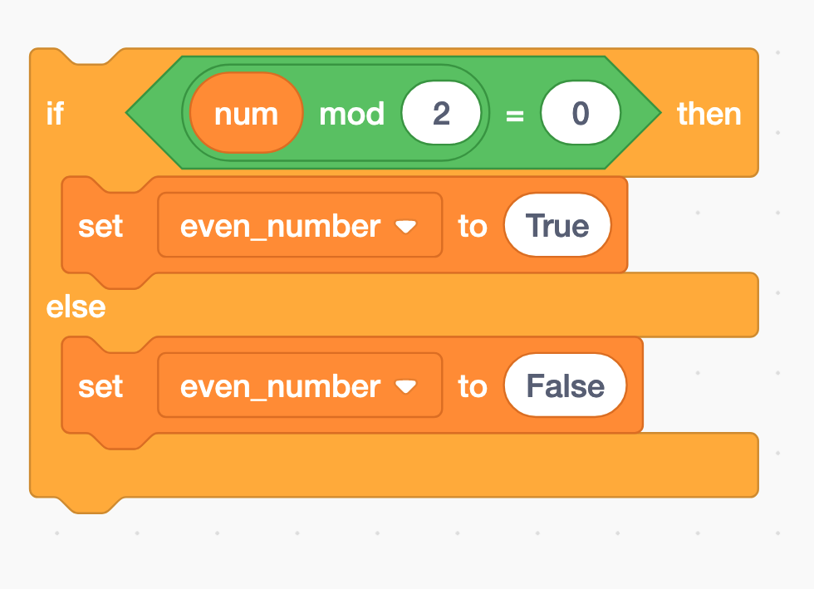
Modulo and if-statements (1) → next weeks
if num % 2 == 0:
even_number = True
else:
even_number = False

Slide 22
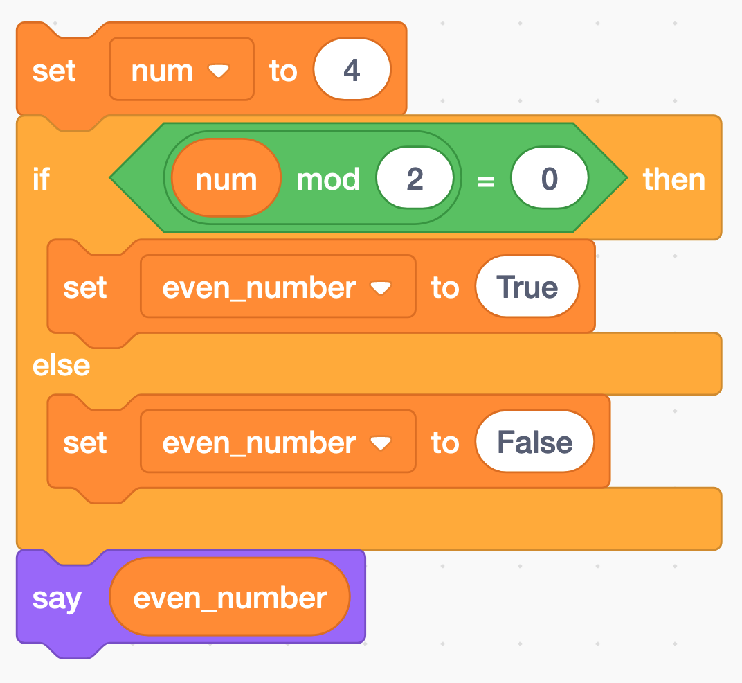
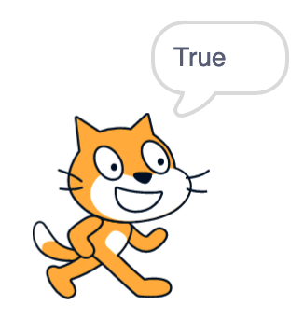
Modulo and if-statements (2) → next weeks
num = 4
if num % 2 == 0:
even_number = True
else:
even_number = False
print(even_number)

Slide 23
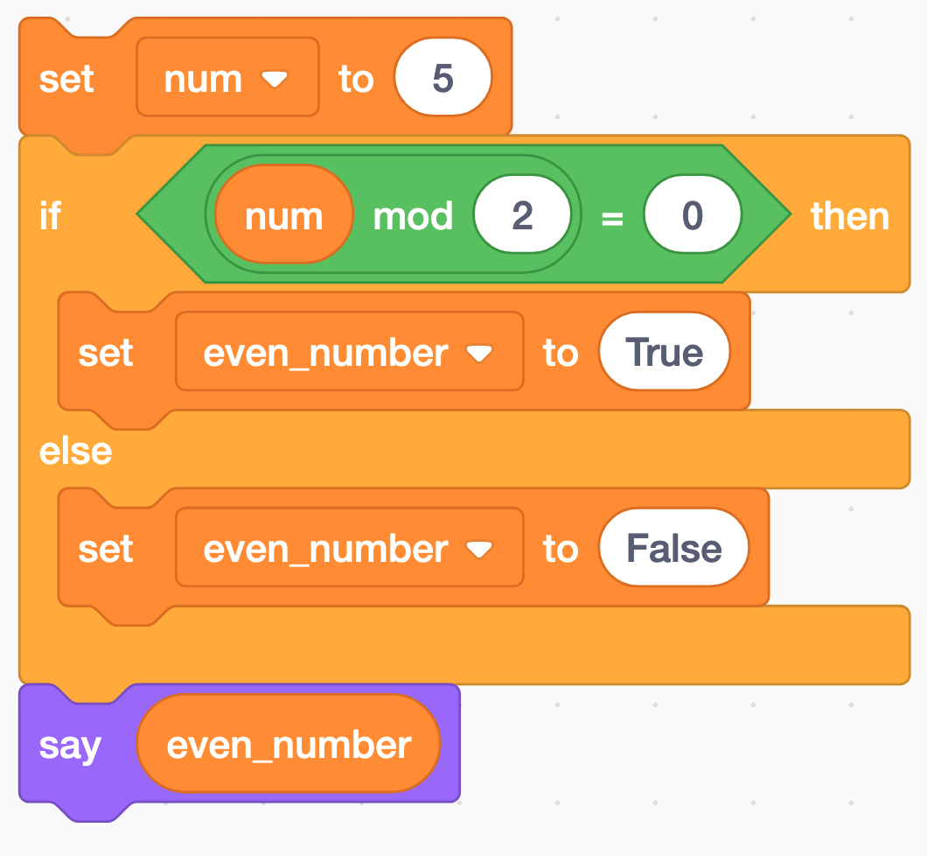
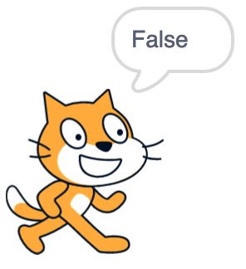
Modulo and if-statements (3) → next weeks
num = 5
if num % 2 == 0:
even_number = True
else:
even_number = False
print(even_number)

Slide 24
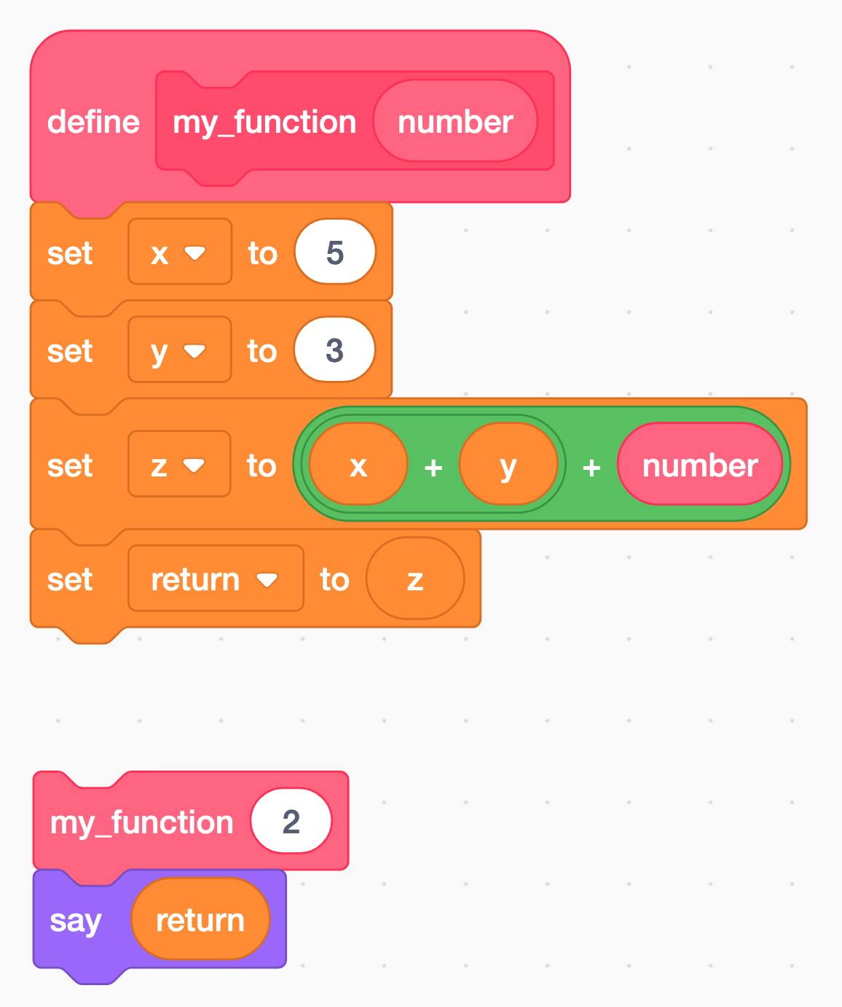
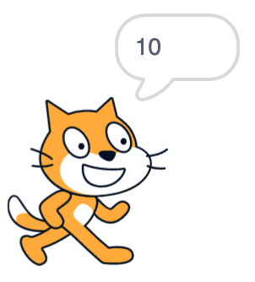
Functions → next weeks
A function is a block of code that only runs when it is called by its function name
You can pass data, known as parameters, into a function.
A function can return data as a result.
def my_function(number):
x = 5
y = 3
z = x + y + number
return z
print(my_function(2)) # this is the function call

Slide 25
Python data types → next weeks
Python has five standard data types:
Numbers
Sequences (Strings, Lists, Tuples)
Dictionaries
Sets
Boolean
Python sets the variable type based on the value that is assigned to it. Unlike more other languages, python will change the variable type if the variable value is set to another value. For example:
var = 123 # this will create a variable with type integer
var = ‘john’ # the “var” variable has now as type string
type(var) # returns the data type of the “var” variable
var_2 = ‘5’
var_2 = int(var_2) # changes the string variable var_2 to an integer variable (if possible)
int | a = 10 | Integer (whole number)
float | a = 45.67 | (.) Floating point real values
Numbers

Slide 26
Let’s find, download, (unzip), load, and work on the first notebook

Slide 27
Introduction to Python:
1.1-1.4
1.7
To read up

Slide 28
Exercise 1:
First, solve the exercise…
…to enable you to solve the assignment on your own!

Slide 29
Helpful web pages
https://stackoverflow.com/
https://www.w3schools.com/python/
https://www.programiz.com/python-programming
https://www.google.ch/?hl=de
https://chat.openai.com/

Slide 30
<Your Name>
<Function>
lirst.last@<student.>unisg.ch

